Slide 1
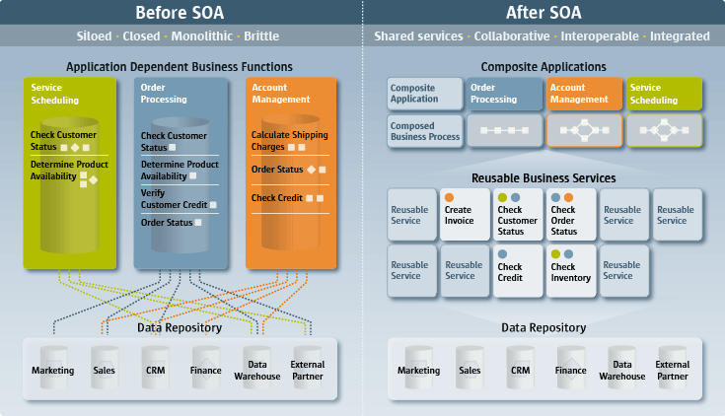
Text mining of social media feeds to perform sentiment analysis for technology release
Dissertation Presentation for MSc. In Computing,
Enterprise Software Systems
Supervisor: Peter Carew
Lecturer in Computing,
Waterford Institute of Technology, Waterford, Co. Waterford
Ireland (Tel: 353-051-302628; e-mail: pcarew@wit.ie)
Author: Ali Akbar Jilani Student, Department of Science and Computing,
Waterford Institute of Technology, Waterford, Co. Waterford
Ireland (Tel: 353-085-212-6940; e-mail: 20078735@mail.wit.ie)

Slide 2

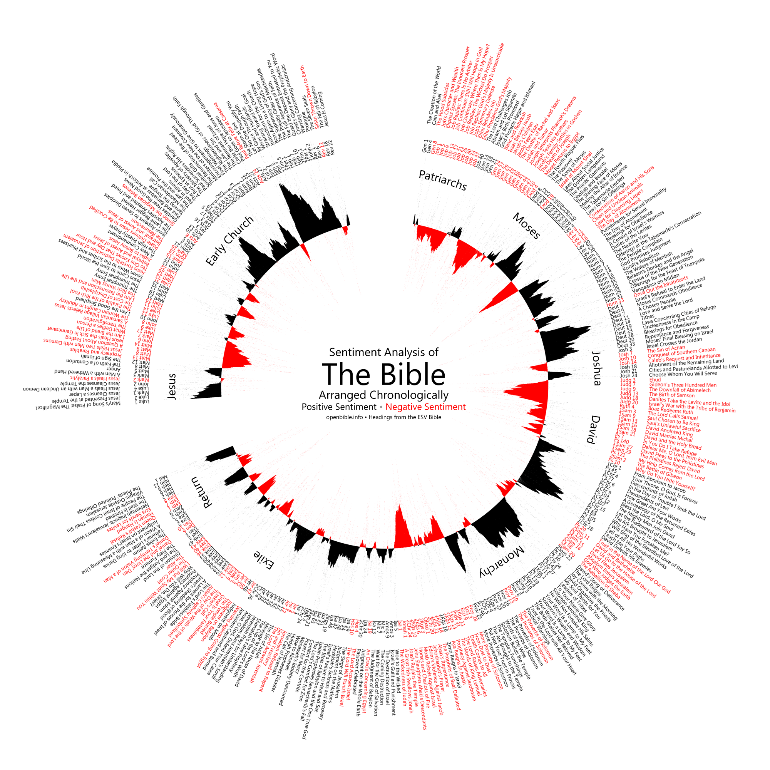

Text mining of social media feeds to perform sentiment analysis for technology release
Supervisor: Peter Carew
Lecturer in Computing,
Waterford Institute of Technology, Waterford, Co. Waterford
Ireland (Tel: 353-051-302628; e-mail: pcarew@wit.ie)
Author: Ali Akbar Jilani Student, Department of Science and Computing,
Waterford Institute of Technology, Waterford, Co. Waterford
Ireland (Tel: 353-085-212-6940; e-mail: 20078735@mail.wit.ie)

Slide 3
Agenda
1
Upgrade Considerations
2
DM Component Configuration
3
The Database
4
The Network
5
Architecture Scenarios

Slide 4




Overview
Day I
Full System Backup
Upgrade Windows
Day II
Install DM 5.3 + Patch 5 on Index03
Upgrade DM Library
Day III
Continue to Upgrade all DM Servers
Test Full System Functionality with Integrations
Restore Database to 11g
Test Upgraded Library
Update Windows on remaining DM Servers

Slide 5













Why Twitter
Social Media Icons Designed by Freepik

Slide 6



Importance
Academic Contribution
Volume of Twitter Sentiment Analysis performed in general using R
Little on Technology Release
Competitive Intelligence & Market Research
Voice of Customer – Source of feedback
Sentiment Analysis in R
R – Programming language (not typo) : (https://www.r-project.org/)
R – Powerful tool for statistical computing and graphics
TM – Text mining package in R

Slide 7



Objectives and RQs
Is it possible to develop a tool or technology to predict success of technology release based upon sentiment analysis performed over pre-release historical social media data?
What would such a tool/ technology look like?

Slide 8
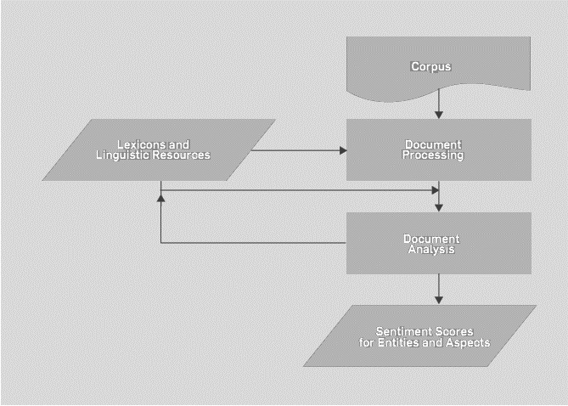
Preliminary literature review 1
Why Twitter
Techniques and Applications for Sentiment Analysis (Ronen Feldman)
Sentiment Analysis - Document / Sentence level / Aspect based / Comparative

Slide 9
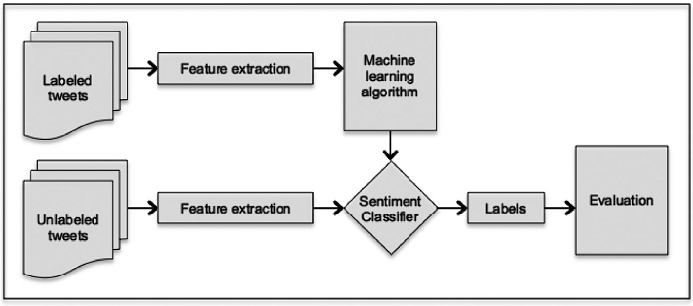
Preliminary literature review 2
Why Twitter
Like It or Not: A Survey of Twitter Sentiment Analysis Methods (Anastasia et al)
TSA - Terminology, Challenges, Methods, Approaches, Data Collection.

Slide 10
Preliminary literature review 3
Why Twitter
Like It or Not: A Survey of Twitter Sentiment Analysis Methods (Anastasia et al)
TSA - Terminology, Challenges, Methods, Approaches, Data Collection.

Slide 11
Literature Coverage to date
Citations | 2009 | 2010 | 2011 | 2012 | 2013 | 2014 | 2015 | 2016 | 2017
CyberEmotions.eu
(Bermingham and Smeaton, 2010)
Mozdeh (www.CREEN.org)
Carol et al
Ronen Feldman
Muhammad Saif et al
Paul Krill
Anastasia et al
Ribeiro et al
Lucan et al

Slide 12
Working Hypotheses
H1: The document sentiment of a tweet and its aggregate sentence level sentiment are equivalents/ correlated.
H2: There is a strong correlation between document (tweet) sentiment score calculated using one technique and the aggregate sentence-sentiment (score) calculated for the same tweet using at least one of the sentence level techniques.
H3: These two techniques (tweet level technique and sentence level technique) are not always the same for every set of tweets taken from the Twitter corpus.

Slide 13
Working Hypotheses
H4: The overall success of a technology release will be likely if the aggregate of these document level sentiment scores is positive and unlikely if their aggregate is negative (falls below zero).
H5: A dominant pattern is visible when all these sentiments are presented using a visualization tool.

Slide 14


Research Design
Tweet
(Technology Release)
Document Level Sentiment Analysis
Sentence Level Sentiment Analysis
Aspect Based Sentiment Analysis
Comparative
Sentiment Analysis
Sentiment Lexicon Acquisition
Support Vector
Machine SVM
Bootstrapping
Approach
W. Support Vector
Machine WSVM
XYZ
Approach
Linear Kernel
SVM
Minimum Cuts
Approach
Naïve Bayes
(NB)
Multi Naïve Bayes
(MNB)
FELDMAN, R. 2013. Techniques and applications for sentiment analysis. Communications of the ACM, 56, 82-89.
Supervised Classification method for sentiment measurement

Slide 15
Research Design

Slide 16
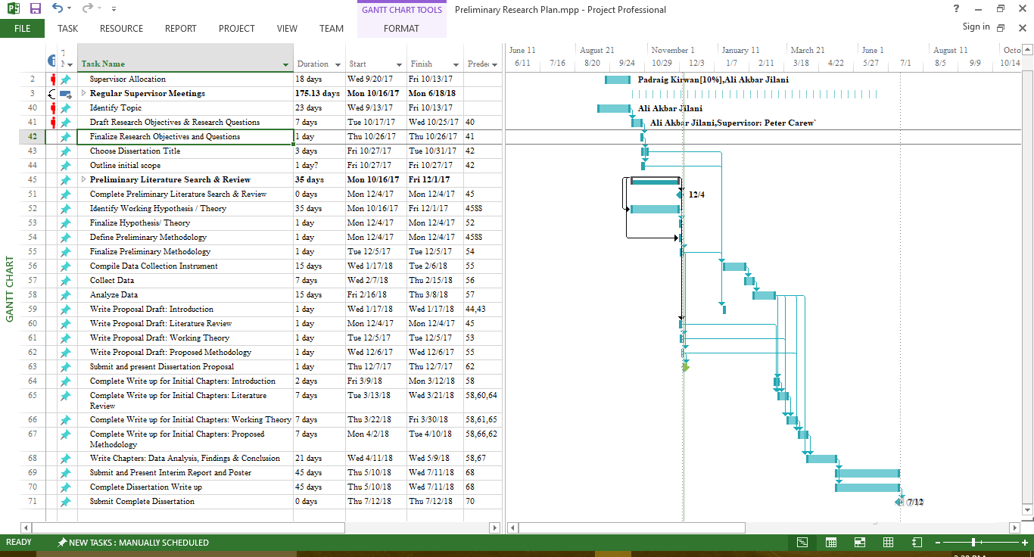
Project Planning

Slide 17
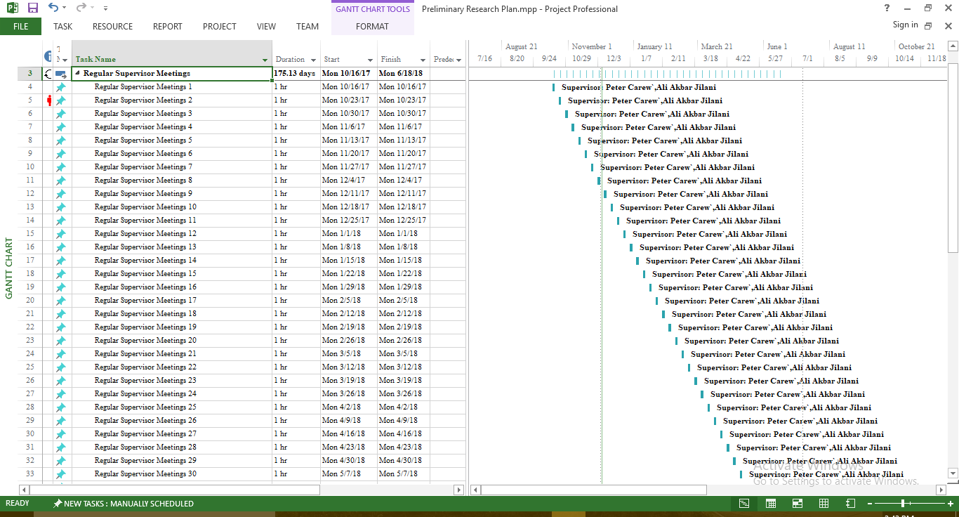
Supervisor Meetings Schedule

Slide 18

Wave 1 Go-live
Wave 2 Go-live
78% completed
Wave 3 Go-live
35% completed
Project kicked off with meeting
Wave 1 UAT Completed
Project closed
Wave 2 UAT
80% completed
Wave 3 UAT
40% completed
Jan 2008 | Mar 2008 | July 2008 | Aug 2008 | Dec 2008 | Jan 2009 | Feb 2009 | Mar. 2009

Slide 19

End of Presentation
Thanks

Slide 20











Slide 21

Content in Action
People
Process
Content
Copyright © 2010 Open Text Corporation. All rights reserved.
21

Slide 22



































Supervised Classification Method for Sentiment Measurement
Document Level
Sentence Level
Aspect Based
Comparative
User Created
Review
Approve
Integrate
Localize
Search
Stemming
Paper
E-Mail
E-Mail
Web
Tokenization
Collaborate
Integrate
Analyze
Part of speech tagging
Graphics
Reports
Library
Portal
Entity Extraction
Audio
Video
Edit
Version
Integrate
Innovate
Print
Relation Extraction
Sentiment Analysis Steps
Corpus
Text Extraction
Pre-processing
Archive
Retention
Disposition

Slide 23
Corporate

Slide 24
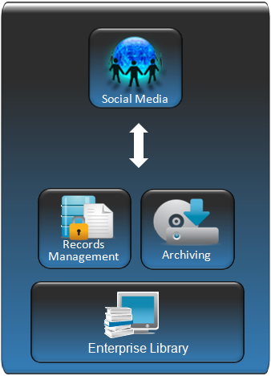
Discussions
Can be configured to capture social content in the Records-managed Archive for compliance, eDiscovery…
Extends information management strategy to include these new types of social content
Transparent to end users
Streams Social Content objects in near real time to Enterprise Library
Integration with eDOCS DM in Q2 Calendar 2010
Blogs
Wikis
Comments

Slide 25
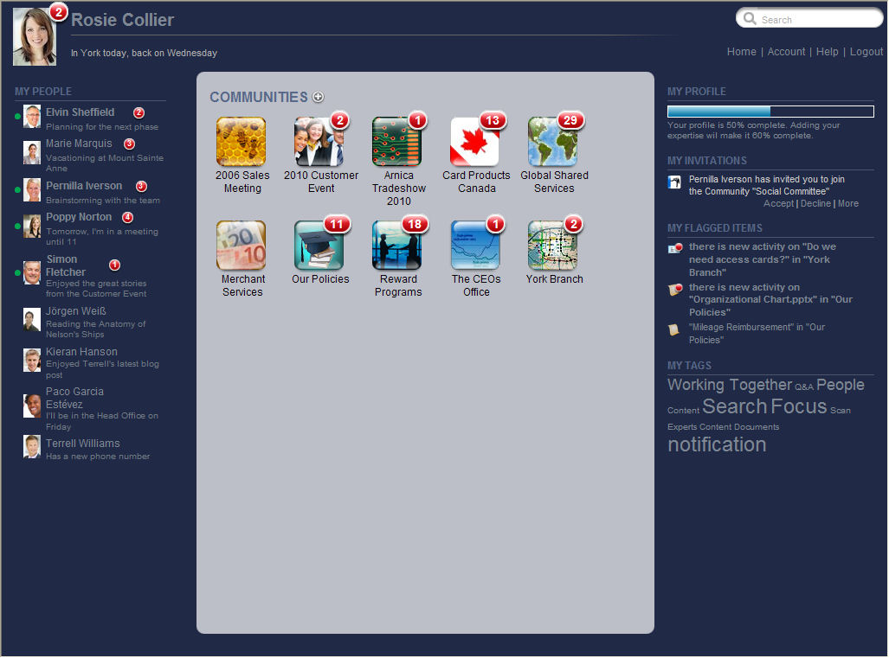
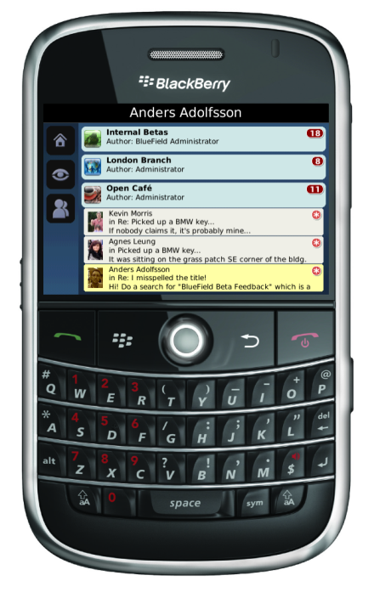
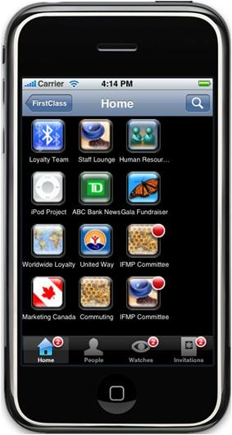
User Profiles and Blogs
Easy-to-use Wikis
Powerful File Sharing
Instant-indexed Social Search
Rich mobile experience on iPhone or Blackberry

Slide 26








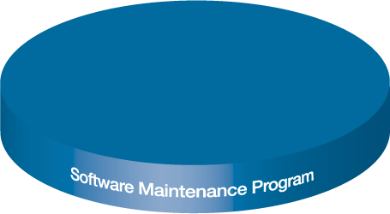
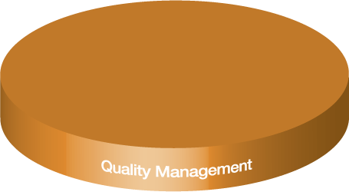
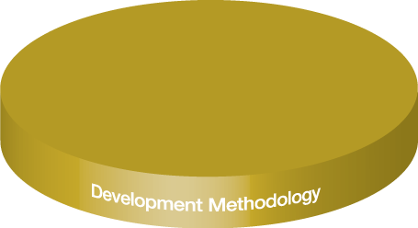

Adoption
Deployment
Learning Services
Customers
Global Services
Production Upgrade Support
Assigned Program Manager
Assigned Technical Consultant
Regular Communication & Reporting
Collective Issue Management
& Prioritization
Review of Customer’s Upgrade Plan
Stand By Support During Cut Over Weekend
Go Live Support 1st Day of Production
Technical Service Days
Other optional Services
Product Enhancement Requests
Product Management

Slide 27
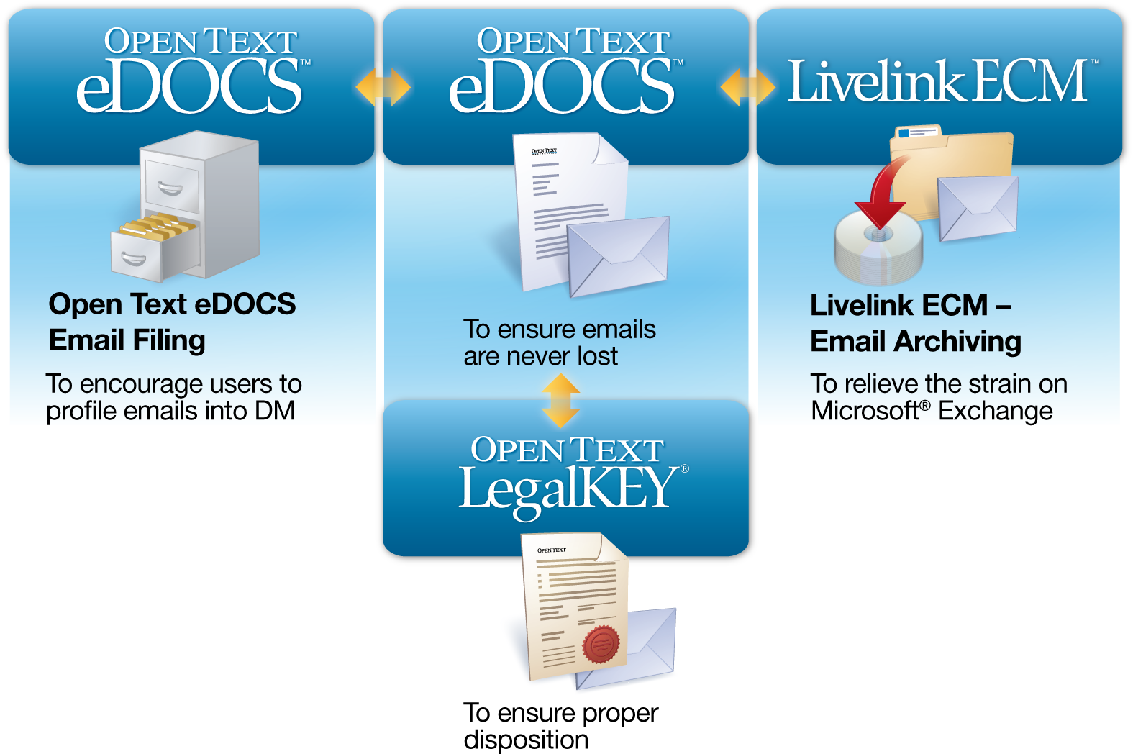
Document Management
Email Filing
Email Archiving
Open Text
Email Marker
Auto Bulk Filing
Filing Assistant
Records Management

Slide 28
eDOCS DM
Active Content will continue to be stored on DM Document Servers
Documents that are edited – versioned
Read-Only or dormant content can be moved to the Enterprise Library
Make Read Only
Configure Target Document Server
DM Workflow
eDOCS Integration for MS SharePoint
Email Archiving Integration for eDOCS
Email Filing
BPM Server integration for eDOCS
DM Imaging
eDOCS RM
eDOCS Integration for Enterprise Library
Archiving
eDOCS DM
Document
Records Management
Sentence
Security Clearance
Aspects of entity
Content Archiving
Windows Server
Directory Services
Novell Netware
Open Text Enterprise Library
Content Server
EMC Centera
Archive Server
Runtime and Core Services
Enterprise Library Services API
Administration Client (MMC)

Slide 29
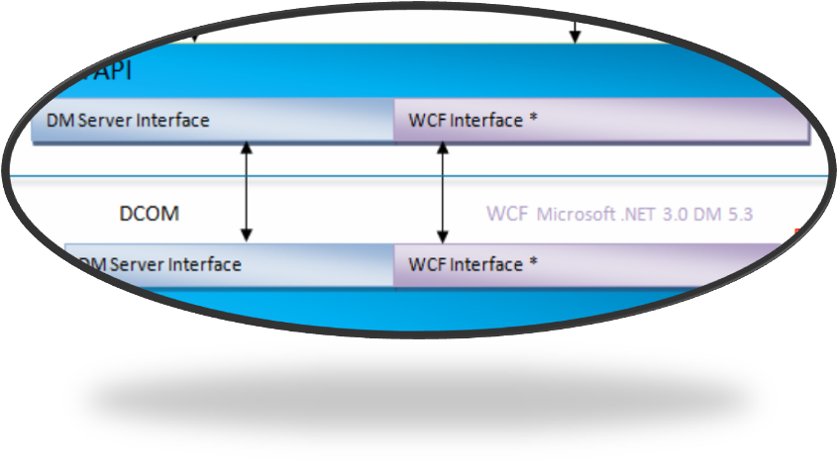



Web Client
Lotus Notes
Windows Explorer
Outlook
Interceptor
Office Apps
HTTP
or SSL
COM
COM
COM & MAPI
Win msgs
COM
VSTO
Microsoft IIS
DM
Extensions
Core
DM Ext.
API
Plugging
Application Integration
FSPlugin
DM Web
Server
RM
Workflow
RM Web
DM Web Admin
Attaché
SAPI
DV
COM
COM
COM
DM API
DM 5.3 CLIENT COMPONENTS
DM Server Interface
WCF Interface *
DCOM
WCF Microsoft .NET 3.0 DM 5.3
DM 5.3 SERVER COMPONENTS
DM API
Workflow Server
Search Server
DM Server Interface
WCF Interface *
COM
Searching
RM Server
Dynamic Views
Preview
Indexer
Profile
DB
Events
Security
Doc. Server
Search Server ODBC
Search Server ODBC
ODBC, Native
Proprietary protocol
Dependant on Doc. store type
THIRD TIER COMPONENTS
SQL DB
Full text Index
SQL DB
MSSQL, Oracle
Document Server
Designer
Import utilities
Custom events sent to HTTP Server
Security Services
NTFS, DSA
SMB
29

Slide 30
Q4 2008
Q1 2009
Q2 2009
Q3 2009
Q4 2009
Q1 2010
Q2 2010
Q3 2010
Q3 2011
Q1 2012
eDOCS DM 5.3
release
Support for Microsoft Office 2010
eDOCS Integration for Enterprise Library RM
DM 5.4 Beta
Next feature release of the eDOCS DM 5.x product line
ECM Suite Advances
Rebranding
Suite Installer
MMC Admin (CDU)
User Management
ECM Suite Advances
MMC Admin - Including Library Maintenance
Legend:
Delivered
In Progress
Proposed

Slide 31












Open Text ECM Suite
User Experience Services
Engagement
Transaction
Lifecycle
Enterprise Process Services
Enterprise Library
Email
GroupWare
Filers
Web Sites
ERP
ERP
Basic ECM
Other ECM
Notes:
31

Slide 32
User Experience Services
Open Text WCM
Social Media
Engagement
Mobility
Collaboration
Enterprise Process Services
Web Content Management
Enterprise Library
Email
GroupWare
Filers
Web Sites
ERP
ERP
Basic ECM
Other ECM
Notes:
32

